Slide 1




Course Yuga
A Minor Project Report Submitted To
Rajiv Gandhi Proudyogiki Vishwavidyalaya, Bhopal
Towards Partial Fulfilment for the Award of
Bachelor of Engineering
In
Computer Science and Engineering
Submitted By :
Utsav Jaiswal (0820CS221062)
Dhruv Jain (0820CS221022)
Shradha Sawant (0820CS221053)
Under the Supervision of
Ms. Sudha Yadav
Department of Computer Science and Engineering

Slide 2

Lakshmi Narain College Of Technology, Indore
CERTIFICATE
This is to certified that the major project entitled “Course Yuga - CMS website” submitted by
Utsav Jaiswal (0820CS221062), Dhruv Jain (0820CS221022) and Shradha Sawant (0820CS221053) is a satisfactory account of the bona fide work carried out under our supervision. It is recommended as partial fulfilment of the requirements for the award of the degree Bachelor of Engineering in Computer Science and Engineering to Rajiv Gandhi Proudyogiki Vishwavidyalaya, Bhopal (M.P.)
Project Guide
Ms. Sudha Yadav
Project In-charge
Ms. Sudha Yadav
HOD-CSE/IT
Ms. Srashti Thakur
Principal
LNCT, Indore (M.P.)
Er. Prakash Bharani

Slide 3
Welcome to Course-Yuga
A Comprehensive CMS + LMS Platform
Bringing Learning and Content Management Together

Slide 4
Why We Need Course-Yuga
- Disjointed user experience in existing systems
- Lack of seamless integration for courses, videos, and community
- Limited interactivity and course management complexity
- High cost of implementing separate systems for CMS and LMS

Slide 5
How Course-Yuga Solves This Problem
Unified course delivery system with seamless integration.
Advanced video streaming with interactive timestamps.
Community features for engagement.
Cost-effective and scalable design for diverse user roles.

Slide 6
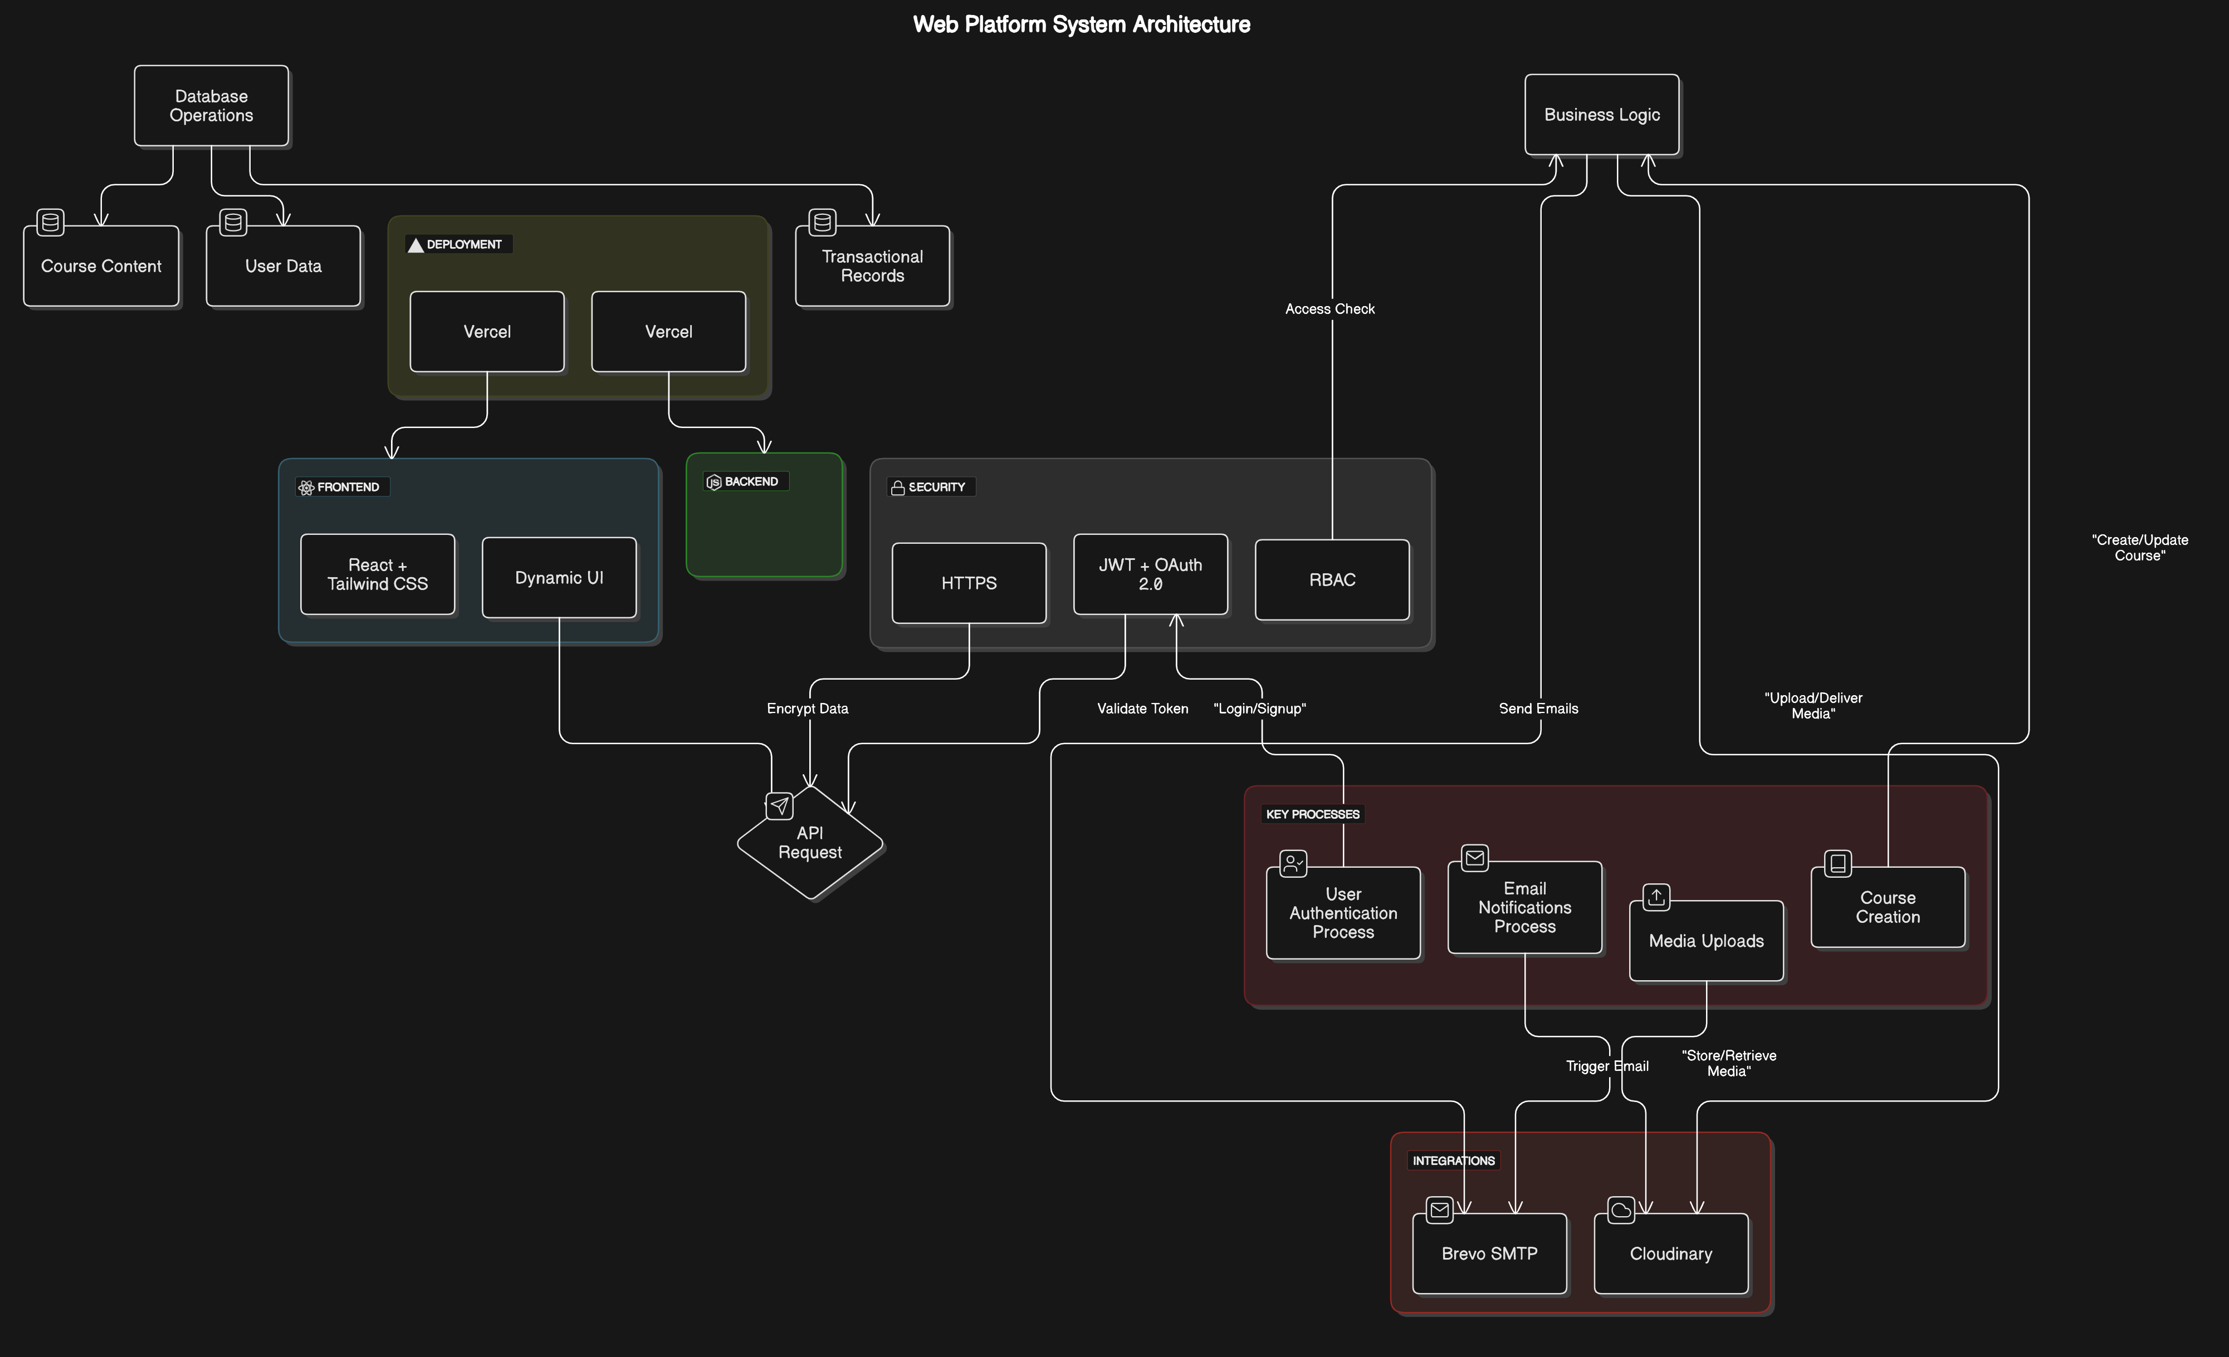
System Design

Slide 7
Technologies
Programming Language: TypeScript
Frontend: React + Tailwind CSS
Backend: Nodejs + Express.js
Database: MongoDB
Integrations: Cloudinary, Brevo SMTP
Deployment: Vercel (Frontend + Backend)
Enhanced security: JWT-based authentication & Oauth2.0

Slide 8
User Interactivity
Enroll in courses and track progress.
Change the role to ADMIN and create their own course.
Watch videos with timestamps or embedded YouTube links.
Bookmark and mark videos as watched.
Engage in the community board.

Slide 9
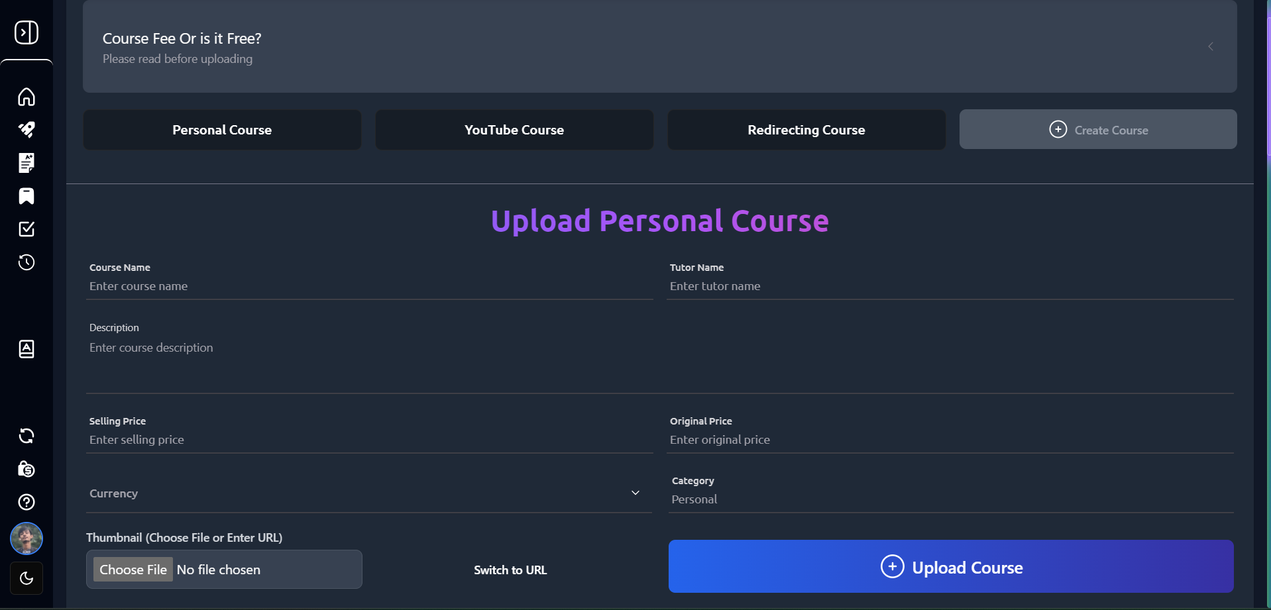
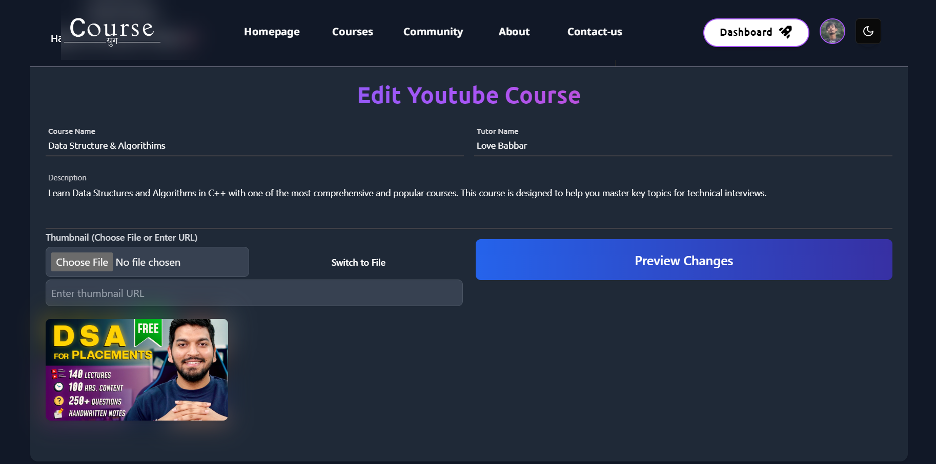
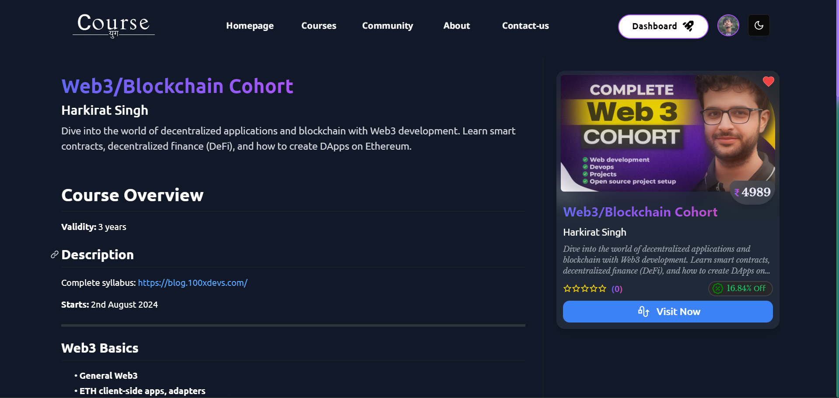
Admin Interactivity
Create and manage courses
Edit course and videos
Set course prices and top up wallets

Slide 10
Web Owner Interactivity
Verify or reject courses and videos
Web owners have the ability to review submitted content for quality and relevance before approval. This ensures a curated library of courses and videos.
Send email notifications for content approval/rejection
Automated email notifications are sent to course creators or admins, keeping them informed about the status of their submissions.
Manage overall platform content quality
Monitor and maintain the platform's integrity by ensuring the uploaded content meets the desired standards of quality and engagement.

Slide 11
Future Enhancement
AI-driven personalized course recommendations
Mobile application for iOS and Android
Advanced analytics for course performance
Multilingual support for global accessibility

Slide 12
Conclusion
Course-Yuga is more than just a platform; it’s a holistic solution to the challenges faced by educational content providers. It offers a robust, scalable, and cost-effective system that will help both content creators and learners achieve their goals with ease.

Slide 13
Thank You!
Course-Yuga
Empowering Learning, Simplifying Content Management
Visit us at: course-yuga.app
Issues: course-yuga-issues
For queries: masterutsav.in@gmail.com

